Slide 1
JAVA
UNIT 4(A)

Slide 2
Inheritance
Inheritance is the mechanism in java by which one class is allow to inherit the features(fields and methods) of another class.
The idea behind inheritance in Java is that you can create new classes that are built upon existing classes. When you inherit from an existing class, you can reuse methods and fields of the parent class.
Moreover, you can add new methods and fields in your current class also.

Slide 3
Why use inheritance in java
For Method Overriding (so runtime polymorphism can be achieved).
For Code Reusability.

Slide 4
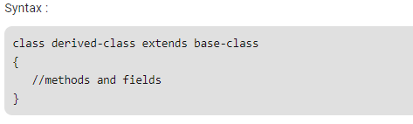
How to use inheritance
The keyword used for inheritance is extends.

Slide 5
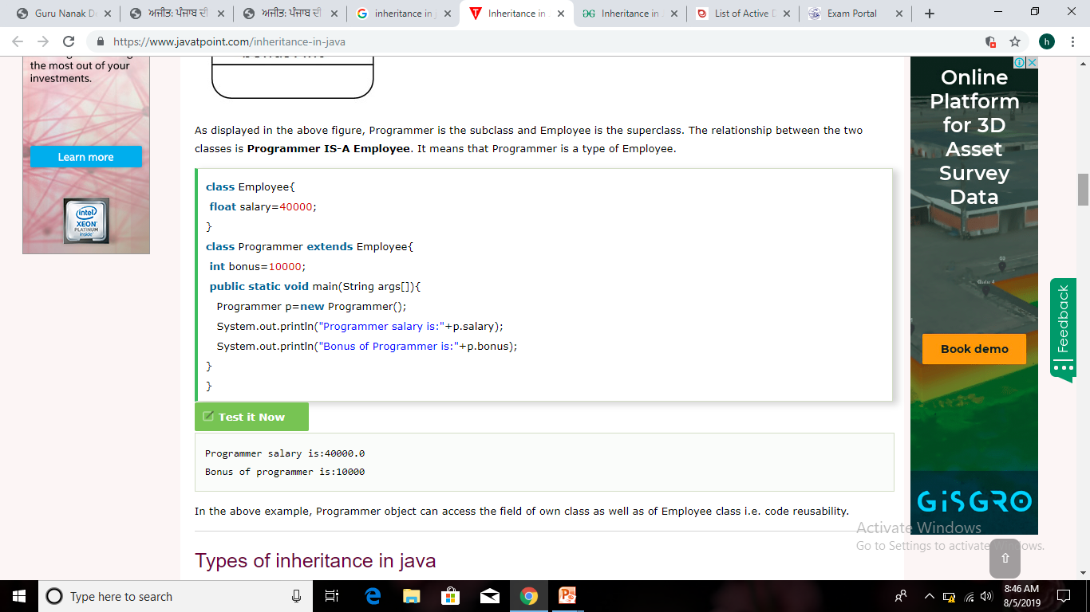
Inheritance: Sample program

Slide 6
Types of inheritance
On the basis of class, there can be three types of inheritance in java: single, multilevel and hierarchical.
In java programming, multiple and hybrid inheritance is supported through interface only. We will learn about interfaces later.

Slide 7
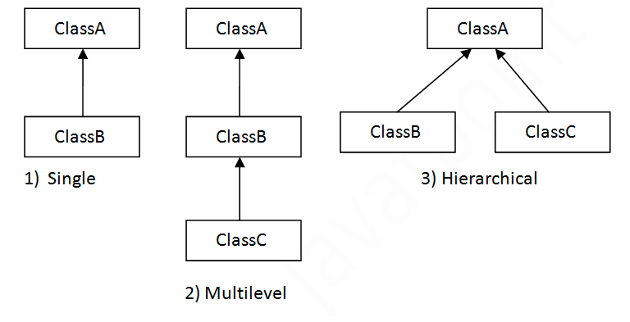
Types of inheritance

Slide 8
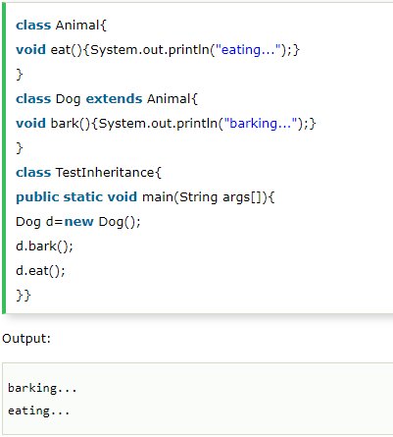
Single Inheritance

Slide 9
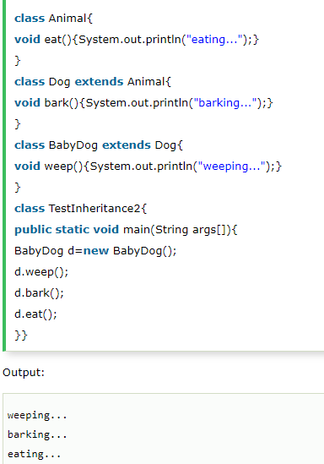
Multilevel Inheritance

Slide 10
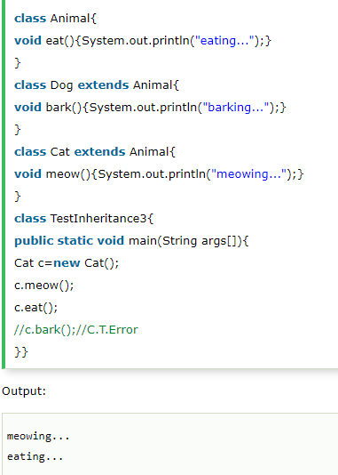
Hierarchical Inheritance

Slide 11
Super keyword
The super keyword in java is a reference variable that is used to refer parent class objects.
The keyword “super” came into the picture with the concept of Inheritance.

Slide 12
Use of super
1) To access the data members of parent class when both parent and child class have member with same name 2) To access the method of parent class when child class has overridden that method. 3) To access the parent class constructor.

Slide 13
To access the variables of parent class
When you have a variable in child class which is already present in the parent class then in order to access the variable of parent class, you need to use the super keyword.

Slide 14
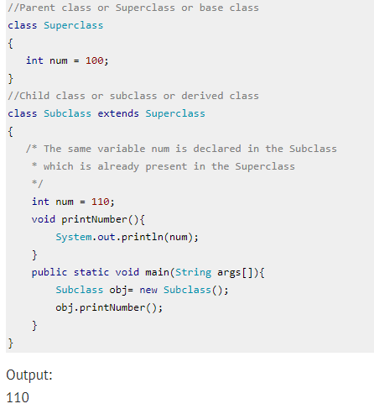

Slide 15
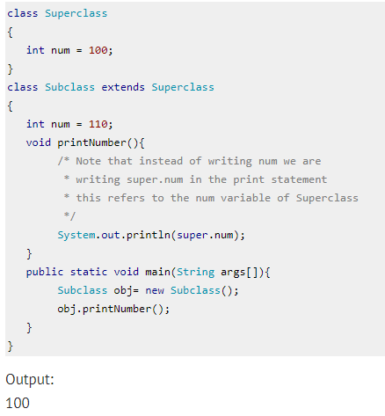
with super

